Slide 1
Chapter 1: Software Re-engineering and Software Maintenance
Software Re-engineering - Undergraduate Course

Slide 2
Course Objectives
Introduce concepts of software re-engineering
Understand difference between maintenance and re-engineering
Explore legacy systems and their challenges
Discuss economic & technical motivations

Slide 3
Definition (Textbook View)
Software re-engineering is the process of improving existing systems.
It focuses on maintainability, performance, and modernization.
Software Re-Engineering is the examination and alteration of a system to reconstitute it in a new form. The principle of Re-Engineering when applied to the software development process is called software re-engineering. It positively affects software cost, quality, customer service, and delivery speed. In Software Re-engineering, we are improving the software to make it more efficient and effective.
It is a process where the software’s design is changed and the source code is created from scratch. Sometimes software engineers notice that certain software product components need more upkeep than other components, necessitating their re-engineering.

Slide 4
Definition (Industry View)
In industry, re-engineering often involves migration to new technology
Preserving business logic while modernizing platforms

Slide 5
Reasons of initiating Software re-engineering
Improving software quality: Re-engineering can help improve the quality of software by eliminating defects, improving performance, and enhancing reliability and maintainability.
Updating technology: Re-engineering can help modernize the software system by updating the technology used to develop, test, and deploy the system.
Enhancing functionality: Re-engineering can help enhance the functionality of the software system by adding new features or improving existing ones.
Resolving issues: Re-engineering can help resolve issues related to scalability, security, or compatibility with other systems.

Slide 6
The software reengineering is necessary for having:
a) Boost up productivity: Software reengineering increase productivity by optimizing the code and database so that processing gets faster.
b) Processes in continuity: The functionality of older software products can be still used while the testing or development of software.
c) Improvement opportunity: Meanwhile the process of software reengineering, not only software qualities, features, and functionality but also your skills are refined, and new ideas hit your mind. This makes the developer’s mind accustomed to capturing new opportunities so that more and more new features can be developed.

Slide 7
d) Reduction in risks: Instead of developing the software product from scratch or from the beginning stage, developers develop the product from its existing stage to enhance some specific features brought in concern by stakeholders or its users. Such kind of practice reduces the chances of fault fallibility.
e) Saves time: As stated above, the product is developed from the existing stage rather than the beginning stage, so the time consumed in software engineering is lesser.
f) Optimization: This process refines the system features, and functionalities and reduces the complexity of the product by consistent optimization as maximum as possible.

Slide 8
Re-engineering can be a costly process, and there are several factors that can affect the cost of re-engineering a software system:
Size and complexity of the software: The larger and more complex the software system, the more time and resources will be required to analyze, design, and modify it.
Number of features to be added or modified: The more features that need to be added or modified, the more time and resources will be required.
Tools and technologies used: The cost of re-engineering can be affected by the tools and technologies used, such as the cost of software development tools and the cost of hardware and infrastructure.
Availability of documentation: If the documentation of the existing system is not available or is not accurate, then it will take more time and resources to understand the system.

Slide 9
Team size and skill level: The size and skill level of the development team can also affect the cost of re-engineering. A larger and more experienced team may be able to complete the project faster and with fewer resources.
Location and rate of the team: The location and rate of the development team can also affect the cost of re-engineering. Hiring a team in a lower-cost location or with lower rates can help to reduce the cost of re-engineering.
Testing and quality assurance: Testing and quality assurance are important aspects of re-engineering, and they can add significant costs to the project.
Post-deployment maintenance: The cost of post-deployment maintenance such as bug fixing, security updates, and feature additions can also play a role in the cost of re-engineering.

Slide 10
Advantages of Re-engineering:
Reduced Risk: As the software is already existing, the risk is less as compared to new software development. Development problems, staffing problems and specification problems are the lots of problems that may arise in new software development.
Reduced Cost: The cost of re-engineering is less than the costs of developing new software.
Better use of Existing Staff: Existing staff expertise can be maintained and extended accommodate new skills during re-engineering.
Improved efficiency: By analyzing and redesigning processes, re-engineering can lead to significant improvements in productivity, speed, and cost-effectiveness.
Increased flexibility: Re-engineering can make systems more adaptable to changing business needs and market conditions.

Slide 11
Better customer service: By redesigning processes to focus on customer needs, re-engineering can lead to improved customer satisfaction and loyalty.
Increased competitiveness: Re-engineering can help organizations become more competitive by improving efficiency, flexibility, and customer service.
Improved quality: Re-engineering can lead to better quality products and services by identifying and eliminating defects and inefficiencies in processes.
Increased innovation: Re-engineering can lead to new and innovative ways of doing things, helping organizations to stay ahead of their competitors.
Improved compliance: Re-engineering can help organizations to comply with industry standards and regulations by identifying and addressing areas of non-compliance.

Slide 12
Disadvantages of Re-engineering:
Major architectural changes or radical reorganizing of the systems data management has to be done manually.
Re-engineered system is not likely to be as maintainable as a new system developed using modern software Re-engineering methods.
High costs: Re-engineering can be a costly process, requiring significant investments in time, resources, and technology.
Disruption to business operations: Re-engineering can disrupt normal business operations and cause inconvenience to customers, employees and other stakeholders.
Resistance to change: Re-engineering can encounter resistance from employees who may be resistant to change and uncomfortable with new processes and technologies.

Slide 13
Risk of failure: Re-engineering projects can fail if they are not planned and executed properly, resulting in wasted resources and lost opportunities.
Lack of employee involvement: Re-engineering projects that are not properly communicated and involve employees, may lead to lack of employee engagement and ownership resulting in failure of the project.
Difficulty in measuring success: Re-engineering can be difficult to measure in terms of success, making it difficult to justify the cost and effort involved.
Difficulty in maintaining continuity: Re-engineering can lead to significant changes in processes and systems, making it difficult to maintain continuity and consistency in the organization.

Slide 14
The re-engineering procedure requires the following steps
Decide which components of the software we want to re-engineer. Is it the complete software or just some components of the software?
Do Reverse Engineering to learn about existing software functionalities.
Perform restructuring of source code if needed for example modifying functional-Oriented programs in Object-Oriented programs
Perform restructuring of data if required
Use Forward Engineering ideas to generate re-engineered software

Slide 15
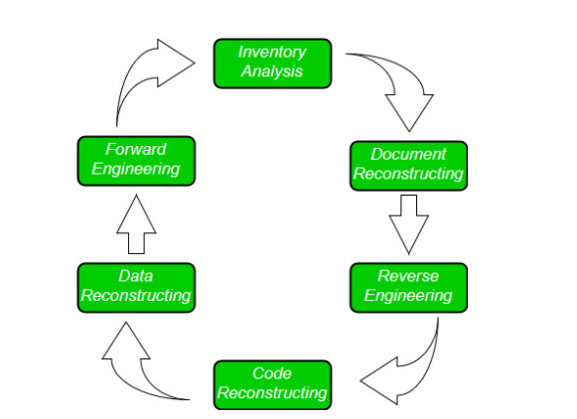
Software Re-Engineering Activities:

Slide 16
1. Inventory Analysis:
Every software organization should have an inventory of all the applications.
Inventory can be nothing more than a spreadsheet model containing information that provides a detailed description of every active application.
By sorting this information according to business criticality, longevity, current maintainability, and other local important criteria, candidates for re-engineering appear.
The resource can then be allocated to a candidate application for re-engineering work.

Slide 17
2. Document reconstructing:
Documentation of a system either explains how it operates or how to use it.
Documentation must be updated.
It may not be necessary to fully document an application.
The system is business-critical and must be fully re-documented.

Slide 18
3. Reverse Engineering:
Reverse engineering is a process of design recovery. Reverse engineering tools extract data and architectural and procedural design information from an existing program.

Slide 19
4. Code Reconstructing:
To accomplish code reconstruction, the source code is analyzed using a reconstructing tool. Violations of structured programming construct are noted and code is then reconstructed.
The resultant restructured code is reviewed and tested to ensure that no anomalies have been introduced.

Slide 20
5. Data Restructuring:
Data restructuring begins with a reverse engineering activity.
The current data architecture is dissected, and the necessary data models are defined.
Data objects and attributes are identified, and existing data structures are reviewed for quality.

Slide 21
6. Forward Engineering:
Forward Engineering also called renovation or reclamation not only recovers design information from existing software but uses this information to alter or reconstitute the existing system to improve its overall quality.

Slide 22
Case Example: Y2K Problem
Millions spent on re-engineering systems to handle 2000 date
Preserved business continuity globally
Notes:
The Y2K problem (also called the Year 2000 problem or the Millennium Bug) was a computer issue that arose because many older computer systems and software stored years using only the last two digits (e.g., 99 for 1999 instead of 1999).
This design saved memory in the early days of computing but created a serious flaw:
When the year rolled over from 99 (1999) to 00 (2000), many systems would interpret 00 as 1900 instead of 2000.
This could cause errors in date-related calculations, sorting, comparisons, or even system crashes.
Example
A bank calculating interest from 1999-12-31 to 2000-01-01 might interpret the second date as 1900-01-01, making it seem like a negative 99-year period.
Air traffic control, billing systems, power grids, and hospital equipment were feared to malfunction.
The Response
In the late 1990s, governments and businesses worldwide spent hundreds of billions of dollars auditing, fixing, and testing software and embedded systems to prevent failures.
The Outcome
Thanks to massive preparation, very few critical failures occurred when the date switched to January 1, 2000.
The Y2K bug is often remembered as a major example of software maintenance, risk management, and large-scale testing.

Slide 23
Software maintenance

Slide 24
Importance of Maintenance
Software maintenance = 60-80% of total lifecycle cost
Ensures system longevity and adaptability
Critical for business continuity
Notes:
daptability is the ability of a system to adjust to changes in its environment, requirements, or technology with minimal effort and cost.

Slide 25
Definition of Maintenance
Modification of software after delivery to correct faults, improve performance, or adapt to environment

Slide 26
Scope of Maintenance
Bug fixes
Performance improvements
Platform adaptation
Security patches
Notes:
A security patch is a small piece of software code released by developers or vendors to fix security vulnerabilities in an application, operating system, or device.

Slide 27
Maintenance vs Development Costs
Development: One-time cost
Maintenance: Recurring cost
Can exceed initial development cost over time

Slide 28
Example: Operating Systems
Windows, Linux, macOS
Constant updates, patches, improvements

Slide 29
Types of Maintenance - Overview
Corrective
Adaptive
Perfective
Preventive

Slide 30
Types of Maintenance Diagram
Corrective
Adaptive
Perfective
Preventive

Slide 31
Corrective Maintenance - Definition
Fixing errors after software delivery
Reactive process
Examples
Fixing login bug in web app
Correcting calculation errors in payroll system

Slide 32
Adaptive Maintenance - Definition
Adapting system to new environment
Proactive process
Examples
Migrating database to cloud
Updating system for new operating system

Slide 33
Perfective Maintenance - Definition
Improving performance or adding features
Examples
Adding search functionality
Improving system response time

Slide 34
Preventive Maintenance - Definition
Modifying software to prevent future issues
Examples
Code refactoring
Improving documentation
Security hardening

Slide 35
Software Maintenance Cycle-Overview
The Software Maintenance Cycle defines the process stages involved in maintaining a software system after its initial release. It ensures the system remains reliable, secure, and aligned with changing user and business needs.

Slide 36
Phases of the Cycle
Identification & Tracing
Problems, errors, or change requests are identified (via users, monitoring tools, or audits).
Requests are logged and traced for further action.
Analysis
Assess the change request or issue.
Determine the impact on the system (cost, risk, time, and resources needed).
Design
Plan modifications or enhancements.
Update design documents, data structures, or architecture if needed.
Implementation
Apply the necessary code changes.
Develop security patches, bug fixes, or feature updates.
Testing
Verify that the changes solve the problem without breaking other functionality.
Includes regression testing.
Delivery & Deployment
Roll out the update/patch to the live environment.
Inform users and provide updated documentation if needed.
Maintenance Review (Post-Delivery)
Evaluate whether the change achieved its purpose.
Monitor for side effects, new errors, or user feedback.
Cycle may restart with new issues.
Notes:
Regression testing is a software testing method to verify that recent changes, such as bug fixes, new features, or code updates, haven't negatively impacted existing, previously working functionalities

Slide 37
Challenges in Maintenance Cycle
1. Identification & Tracing Challenges
Poorly documented systems make it hard to trace errors.
Legacy code may lack proper logging/monitoring.
Users may report vague or incomplete issues.
2. Analysis Challenges
High impact analysis cost (time-consuming to evaluate ripple effects).
Hidden dependencies in old systems.
Lack of skilled personnel familiar with outdated technology.
3. Design Challenges
Difficult to fit changes into rigid or poorly structured systems.
Technical debt and spaghetti code reduce flexibility.
Limited modularity makes small changes complex.
Notes:
Logging=sorting
Ripple=wave/wrinkle

Slide 38
4. Implementation Challenges
Fear of breaking existing functionality.
Lack of coding standards in older systems.
Inconsistent environments (development vs. production).
5. Testing Challenges
Incomplete or outdated test cases.
Regression testing is time-intensive.
Legacy systems may not support automated testing easily.
6. Deployment Challenges
Downtime risks during patch/upgrade.
Integration with modern systems may fail.
Version control and rollback issues.
7. Review & Monitoring Challenges
Users may resist changes (training & acceptance issues).
Continuous monitoring adds operational cost.
Fixes may introduce new bugs, restarting the cycle.

Slide 39
Maintenance vs Re-engineering
Maintenance: minor fixes and adaptations
Re-engineering: significant restructuring
Maintenance = keep it running
Re-engineering = make it better for the long term

Slide 40
Maintenance Workflow
Detect Issue
Apply Fix
Test
Deploy

Slide 41
Re-engineering Workflow
Analyze
Reverse Engineer
Refactor
Test & Deploy

Slide 42
Comparison table
Aspect | Software Re-engineering | Software Maintenance
Definition | The process of analyzing and modifying an existing system to improve its structure, performance, and maintainability without changing its core functionality. | The process of modifying a software system after delivery to correct faults, improve performance, or adapt it to a changed environment.
Goal | Improve system quality, structure, and longevity. | Keep the system operational and useful for end-users.
Focus | Long-term improvement, modernization, and restructuring. | Immediate fixes, adaptations, and small enhancements.
Scope of Change | Larger, system-wide changes (e.g., redesigning modules, re-documentation, migrating platforms). | Smaller, localized changes (bug fixes, updates, patches).

Slide 43
Nature of Work | Preventive and perfective in nature. | Corrective, adaptive, and perfective.
Approach | More strategic – focuses on improving design, removing technical debt, and increasing maintainability. | More tactical – addresses issues as they arise to keep system running.
Cost & Effort | Higher upfront cost but reduces long-term maintenance costs. | Generally lower short-term cost but can accumulate higher costs over time if frequent.
Examples | - Migrating a legacy system from COBOL to Java. - Re-structuring code for modularity. - Database re-engineering. | - Fixing bugs. - Updating software for new OS compatibility. - Adding small features requested by users.
Outcome | A modernized, maintainable, and often extended software system. | A system that continues to function correctly and meets current needs.
Notes:
Debt=responsibility

Slide 44
Advantages of Maintenance
Quick fixes
Low immediate cost
Minimal disruption

Slide 45
Advantages of Re-engineering
Improves system life
Adopts modern technologies
Improves documentation and quality

Slide 46
Case Study - Online Banking System
Legacy core banking system
Initially maintained with corrective updates

Slide 47
Case Study - Problems
Unable to integrate with mobile apps
High maintenance costs
Security concerns

Slide 48
Case Study - Evolution
Adaptive maintenance to support ATMs and online portals
Perfective maintenance to improve performance
Preventive maintenance for security hardening

Slide 49
Case Study - Re-engineering Need
Eventually re-engineered to cloud-based microservices
Improved scalability and integration

Slide 50
Lehman’s Laws of Software Evolution - Overview
Manny Lehman studied large, real-world evolving software systems and proposed eight laws that describe their behavior. These are widely accepted in software engineering.
Laws describe inevitable trends in long-lived software systems

Slide 51
Lehman’s Law: Continuing Change
A software system must continually evolve, or it becomes progressively less useful in a changing environment.
Example: Banking software must keep updating for new regulations and customer needs.
Notes:
Evolve=change/grow/progress

Slide 52
Lehman’s Law: Increasing Complexity
As software evolves, its complexity increases unless measures (like refactoring) are taken.
Without regular restructuring, the system becomes harder to maintain.

Slide 53
Lehman’s Law: Self-Regulation
Software evolution is a self-regulating process, with measurable attributes (like productivity, quality, resources) tending towards equilibrium.
Example
Suppose a team maintains a large banking software system.
Management hires 10 more developers to double the speed of updates.
Instead, output stabilizes — maybe it only increases slightly — because:
New developers need training (loss of productivity).
Code complexity increases.
Communication overhead rises.
Eventually, the system returns to a “steady-state” rate of evolution.
Notes:
Evolution follows an equilibrium-like behavior.
Just like traffic flow or ecosystems, natural limits balance productivity, complexity, and quality.
Equilibrium is a state of balance achieved in a reversible process where the rate of the forward process equals the rate of the reverse process, resulting in no net change in the system's overall properties or concentrations of reactants and products over time.

Slide 54
Lehman’s Law: Conservation of Organizational Stability (Invariant Work Rate)
The rate of development of a software system tends to remain constant over its lifetime.
Example: Even with more people, output per unit time remains relatively stable.

Slide 55
Lehman’s Law: Conservation of Familiarity
As a system evolves, developers must maintain familiarity with it.
This restricts the rate of growth, since too many changes at once reduce understanding and stability.

Slide 56
Lehman’s Law: Continuing Growth
Functional capability of software must continually increase to maintain user satisfaction over time.
Example: Mobile apps keep adding new features to retain users.

Slide 57
Lehman’s Law: Declining Quality
Unless rigorously maintained and adapted, software quality declines over time.
Example: Performance issues, outdated dependencies, security vulnerabilities.

Slide 58
Lehman’s Law: Feedback System
Software evolution involves multi-level feedback, and successful evolution depends on effective feedback mechanisms.
Example: User feedback, bug reports, performance monitoring.

Slide 59
Summary of Lehman’s Laws
Change is inevitable
Complexity grows
Quality declines without active maintenance
Growth is necessary but constrained
In short, Lehman’s laws highlight that software systems are like living creatures — they must evolve continuously, otherwise they degrade and die

Slide 60
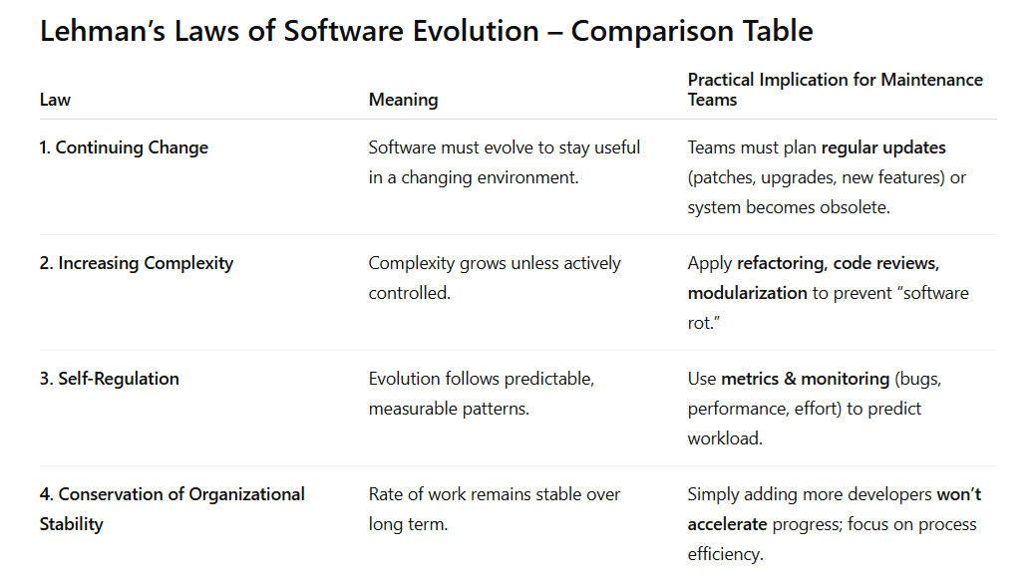
Notes:
Rot=decay

Slide 61
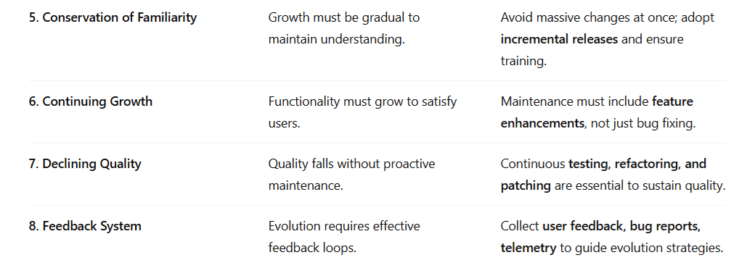
Notes:
Telemetry=Telemetry is the process of gathering the performance data of any product and communicating it to a remote location for monitoring and analysis.

Slide 62
Summary - Key Points
Maintenance is essential for software longevity
Four types of maintenance: Corrective, Adaptive, Perfective, Preventive
Lehman’s Laws highlight inevitable trends in evolution

